Slide 1
Inside The Human Body Systems

Slide 2
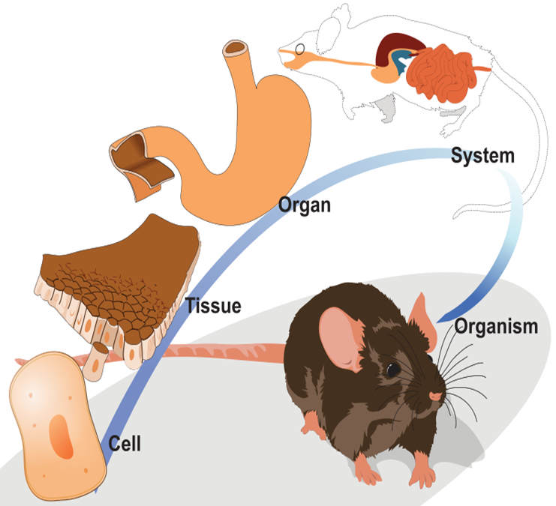
Levels of Organization
The human body is organized in several levels, from the simplest to the most complex starting with. . .
Cells – the basic unit of life
Tissues – clusters of cells performing a similar function
Organs – made of tissues that perform one specific function
Organ Systems – groups of organs that perform a specific purpose in the human body
Notes:
By LadyofHats (Own work) [CC0], via Wikimedia Commons
https://commons.wikimedia.org/wiki/File%3AOrganization_levels_mouse.svg

Slide 3
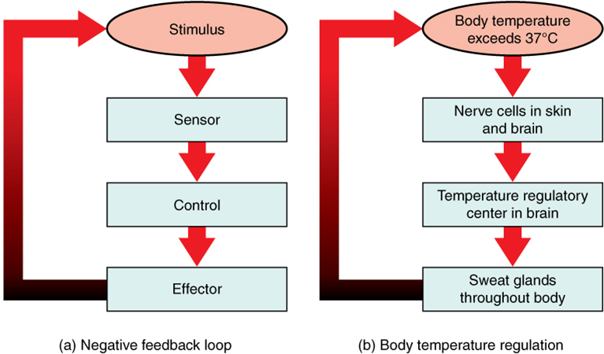
Homeostasis
Your body is like a jigsaw. It's made up of trillions of cells and these cells makeup tissues which makeup organs which make up organ systems which make organisms.
The cells tissues organs and organ systems work together to keep inside your body stable even when outside conditions are changing.
For example your body staying 98 degrees despite the temperature outside being colder/warmer.
Keeping the conditions inside your body constant is called homeostasis.
Notes:
OpenStax, Wikimedia Commons, https://en.wikipedia.org/wiki/User:Trevithj/Negative_feedback (CC BY 4.0)

Slide 4
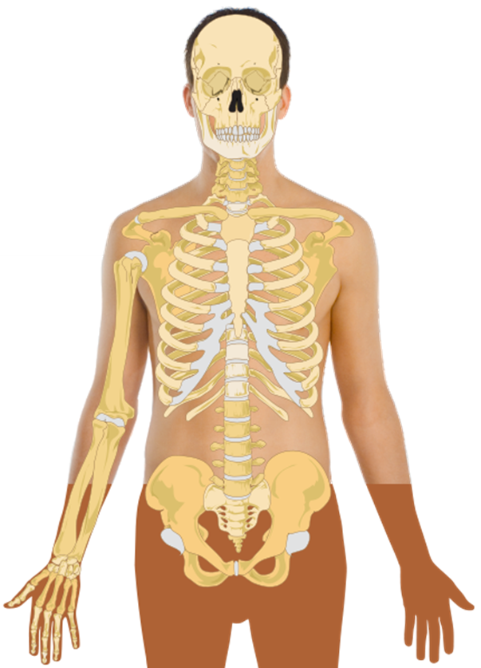
Musculoskeletal (skeletal)
The skeletal system is made up of bones and cartilage that forms the framework of your body.
Functions
To support your body and give it shape.
To protect your internal organs
To provide a scaffolding for your muscles, allowing you to move.
To store minerals and make blood cells.
Major Organs and their Functions:
Bones- major structure in the skeletal system
Joints- parts of your body where two or more bones meet.
Ligaments- hold the bones of many joints together connected by bands of tissues.
Red Marrow- makes blood cells
Notes:
Mikael Häggström, Wikimedia Commons, https://commons.wikimedia.org/wiki/File%3AHuman_skeleton_(svg_template).svg (CC0)

Slide 5
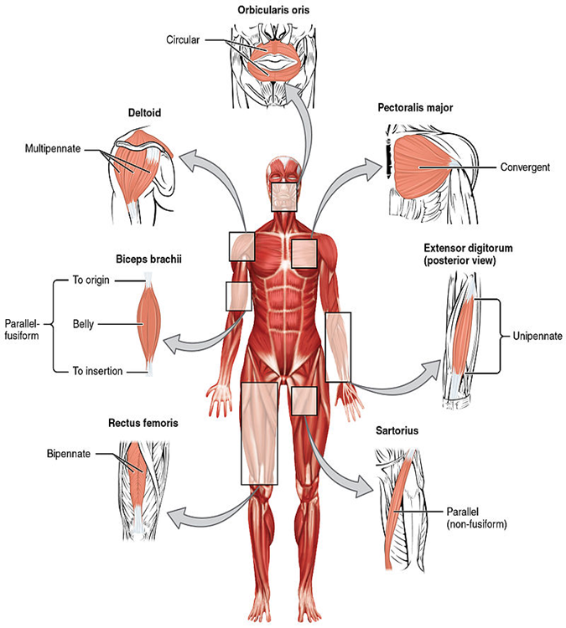
Musculoskeletal (Muscular)
The Muscular Systems includes the muscles that help you move, and muscles that help things inside your body move.
Function
Helps the body move.
There are two types of muscle
Voluntary Muscles- muscle move control by you
Example –moving your arm
Involuntary Muscles- muscles that are not under your conscious control
Example – your heart beating

Slide 6
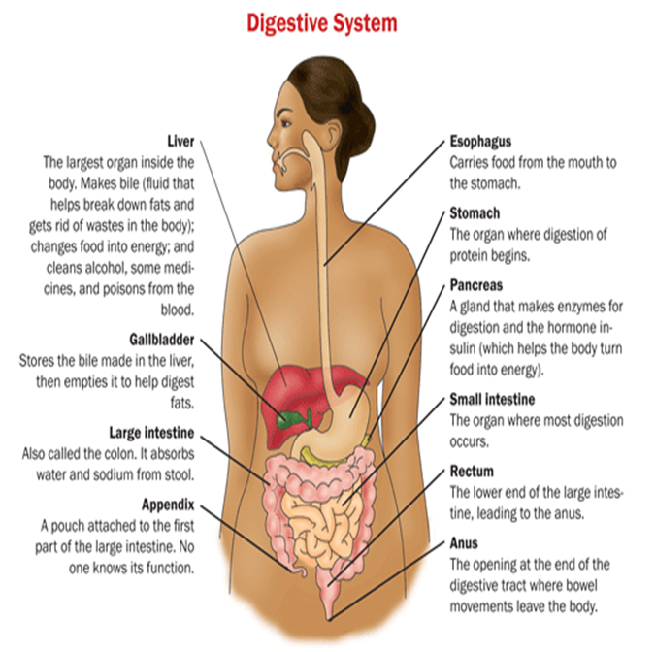
The Digestive System
Functions: breaks down food so it can be absorbed into the bloodstream and used by the body
Major Organs and their Functions:
Mouth – to chew and grind up food
Esophagus – pipe connecting mouth to stomach
Stomach – secretes an extraordinarily strong acid (pH = 2) that leads to breakdown of food
Pancreas – produces the hormone insulin that regulates blood sugar levels
Liver – breaks down fats in foods
Small Intestine – where most digestion takes place then absorbed into the bloodstream
Large Intestine – removes water from the undigested (waste) and get it ready for excretion
Notes:
Office on Women's Health USA Department of Health and Human Services, Wikimedia Commons, https://commons.wikimedia.org/wiki/File%3AGastrointestinal_system.gif (CC0)

Slide 7
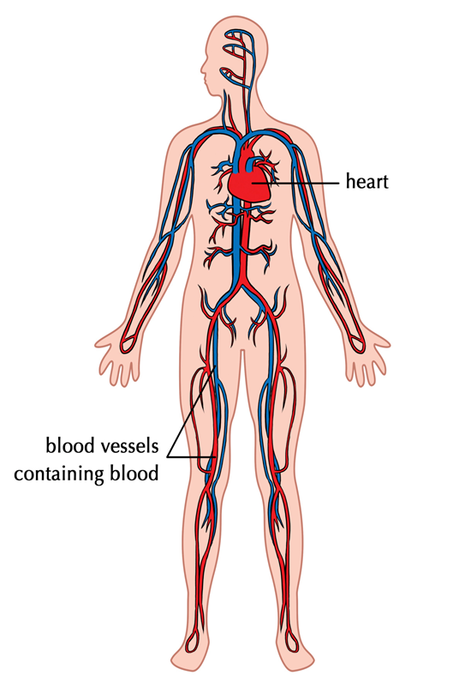
The Circulatory System
Delivers oxygenated blood, nutrients, and hormones. As well as carry away carbon dioxide and waste through the body
Major Organs and Their Functions
Heart – the major muscle of the circulatory system pumps blood through its four chambers (two ventricles and two atria)
-- pumps deoxygenated blood into the lungs, where it gets oxygenated, returned to the heart, and then pumped out through the aorta to the rest of the body
- valve regulate the flow of blood between the chambers
Notes:
Siyavula Education, Flickr, https://www.flickr.com/photos/121935927@N06/13579205034 (CC BY 2.0)

Slide 8
The Circulatory System (continued)
Arteries –thickest blood vessel that carries oxygen rich blood away from the heart and to the major organs of the body
Veins –blood vessel that carries carbon dioxide rich blood back to the heart away from the major organs of the body
Capillaries –thinnest vessels where gas exchange occurs
Blood – the cells that flow through the circulatory system
-- red blood cells contain hemoglobin, an iron-rich protein that carries oxygen
-- white blood cells function in the immune system
-- platelets help in blood clotting

Slide 9
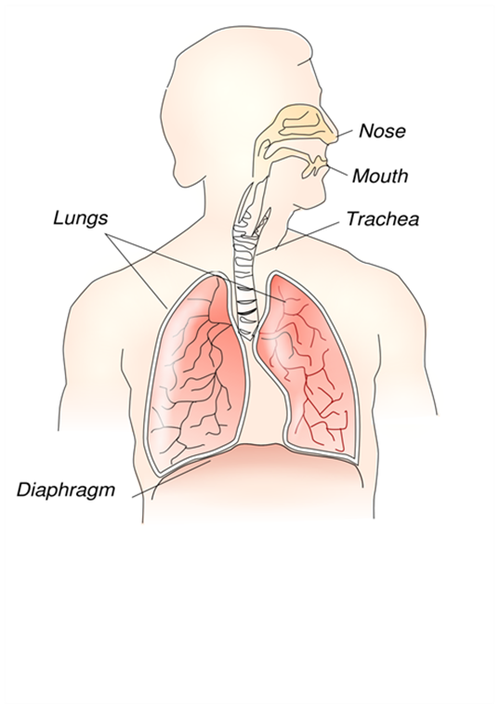
The Respiratory System
Function : to provide the body with a fresh supply of oxygen for cellular respiration and remove the waste product carbon dioxide
Major Organs and Their Functions
Nose – internal entry and exit point for air
Larynx – your “voice-box”, as air passes over your vocal chords, you speak
Trachea – the “windpipe”, carries air to the bronchi
Lungs- main organ in the Respiratory System where carbon dioxide and oxygen are exchanged.
Bronchi – the two large passageways that lead from the trachea to your lungs (one for each lung)
Alveoli- clusters, like grapes where air exchange take place
Diaphragm – strong muscle that causes you to breath
Notes:
Siyavula Education, Flickr, https://www.flickr.com/photos/121935927@N06/13579205034 (CC BY 2.0)

Slide 10
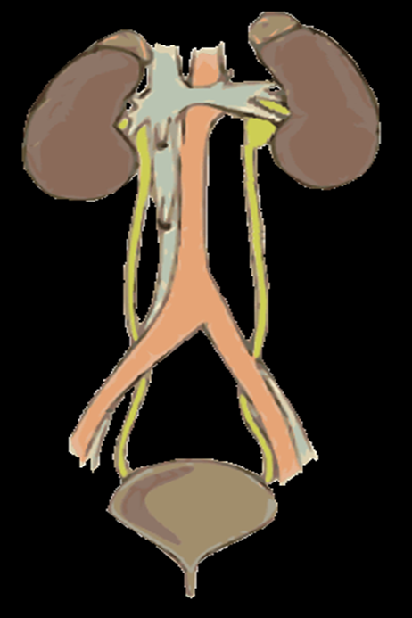
The Excretory System
Function : rid the body of wastes, including excess water and salts
Major Organs and Their Functions
Kidneys – the main organs of the excretory system blood Filled waste enters the kidney and the kidney filters out urea, excess water and other waste products making urine.
Ureter- A tube that carries urine from the kidney to the urinary bladder.
Urethra – a tube that carries urine out the body
Rectum – solid (food) waste travels out of the body through the rectum
Skin – sweat glands remove excess water and salts from the body
( perspiration- liquid waste that leaves the body through the skin and control the body temperature)
Lungs – expel the waste gas carbon dioxide
Notes:
Mikael Häggström, Wikimedia Commons, https://commons.wikimedia.org/wiki/File%3AUrinary_system_-_with_vessels.gif (CC0)

Slide 11
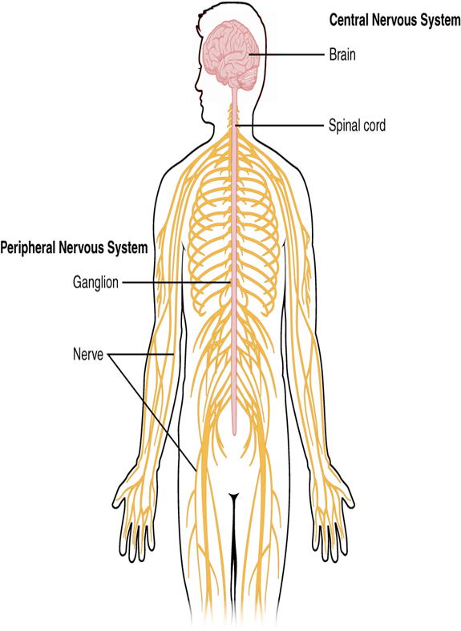
The Nervous System
Function: coordinate the body’s response to changes in its internal and external environment
Two parts of nervous system
1. Central Nervous system –
Made up of brain and spinal cord, control all activities of the body
2. Peripheral Nervous System-
Made up of all the nerves outside of CNS, and carries messages between CNS to all parts of the body
Major Organs and Their Functions
Brain – control center of the body for actions, thoughts and emotions
Spinal Cord – sends instructions from the brain to the rest of the body
Nerves – conduct impulses to muscle cells throughout the body
Notes:
OpenStax College, Wikimedia Commons, http://creativecommons.org/licenses/by/3.0 (CC BY 3.0)

Slide 12
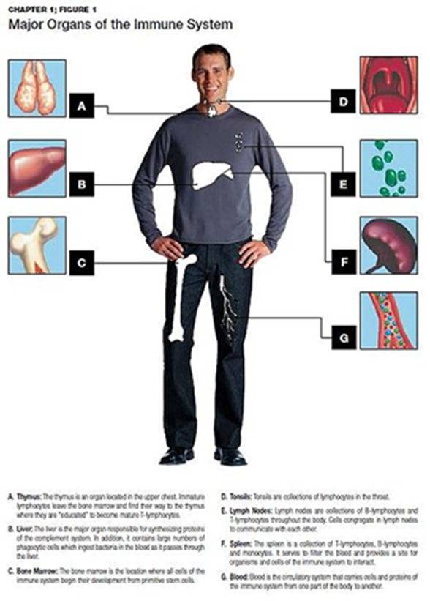
The Immune System
The immune system helps to protect us against diseases caused by tiny invaders (called pathogens) such as viruses, bacteria, and parasites. The immune system is made up of specialized organs, cells, and tissues that all work together to destroy these invaders.
Spleen-the organ that is responsible for both the storage and purification of red blood cells. purifies the blood and helps the immune system to recognize and attack foreign pathogens and allergens
Lymph nodes-help your body recognize and fight germs, infections, and other foreign substances.
Thymus- produces immune cells called T-lymphocytes. These special T-cells protect the body against foreign pathogens such as bacteria and viruses.
Bone marrow- produces blood cells, called red blood cells, platelets, and white blood cell.
White blood cells- help the body fight against infection.
Platelets - blood cells that coagulate (stick together) to help stop bleeding. Platelets form the scab that is formed over a small cut.
Notes:
Scalesmd, Wikimedia Commons, http://www.gnu.org/copyleft/fdl.html (CC BY-SA 3.0 )

Slide 13
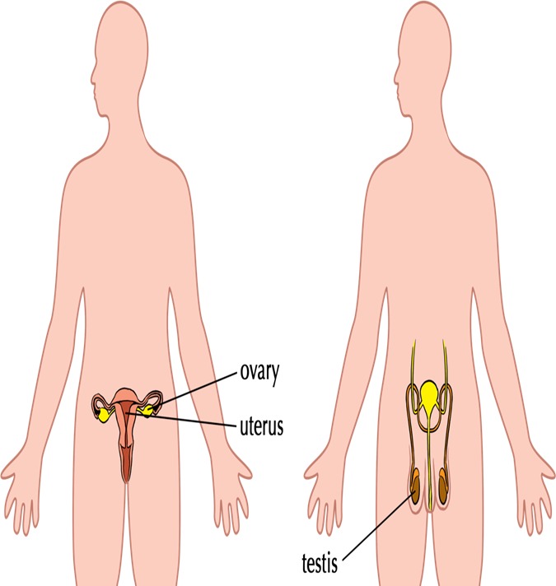
The Reproductive System
Reproductive System for producing offspring
Male
Testicles- male organs that make sperm cells.
Penis – male external sex organ
Female
Ovaries- The two ovaries contain hundreds of undeveloped female sex cells called egg cells or ova
Uterus is where a baby develops until its birth
Fallopian tube- connects ovary to the uterus.
Vagina – female sex organ

